Slide 1
Introduction to Data Analysis in R – Day 2
Randi L. Garcia, PhD
DATIC Introduction to R Workshop
Session 1: June 7th and 8th
Session 2: June 21st and 22nd

Slide 2
Day 2
ANOVA and regression
Preparing APA style manuscripts
Exploratory Factor Analysis (EFA)
Confirmatory Factor Analysis (CFA)
Path Analysis and Structural Equation Modeling (time?)

Slide 3
ANOVA and Regression

Slide 4
ANOVA and Regression
Analysis of Variance (ANOVA) is used to compare the means of a numerical variable across levels of a categorical variable (3+ levels)
Only 2 levels, what test do we use?
Simple Linear Regression (SLR) is used to find the relationship between one numerical predictor variable and one numerical response (outcome or DV) variable.
Multiple Regression is used to find the relationship between predictor and response controlling for other variables.

Slide 5
ANOVA and Regression
Logistic Regression is used to model the probability of being in a certain group based on numerical predictors.
i.e., The response variable is dichotomous
This is called a Generalized Linear Model (GLM)
χ²-Test (Chi-squared Test) is used to test if two categorical variables are associated.
For example, is the distribution of education levels more skewed towards higher degrees for men than for women?

Slide 6
ANOVA and Regression
 | Response (DV or outcome variable)
Explanatory (IV or predictor) | Numerical | Categorical (2 levels: dichotomous)
Categorical (levels = 2) | t-Test | χ²-Test (two-prop test)
1 Numerical | SLR | Logistic Regression
Categorical (levels >= 3) | ANOVA | χ²-Test
2 or more Numerical | Multiple Regression | Logistic Regression

Slide 7
ANOVA and Regression
Inference Test | R function
t-Test | t.test()
ANOVA | aov()
SLR and Multiple Regression | lm()
χ²-Test | chisq.test()
Logistic Regression | glm()

Slide 8
R Markdown file
ANOVA and regression.Rmd

Slide 9
Reproducibility with r markdown

Slide 10

Reproducibility
Replicability versus reproducibility
Replicability – similar results when you re-run a study, collecting entirely new data
Reproducibility – getting the exact same numbers when you re-run analyses using the same data
Perhaps the biggest advantage to using R is that our analyses can be made fully reproducible with R Markdown and the knitr package (Xie, 2015).
Reproducibility is a lower bar than replicability
the software statcheck (Epskamp & Nuijten, 2014) has found many errors in the psychological literature (Veldkamp, Nuijten, Dominguez-Alvarez, Assen, & Wicherts, 2014)

Slide 11
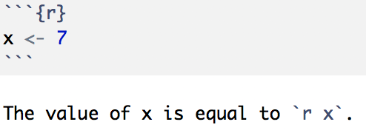
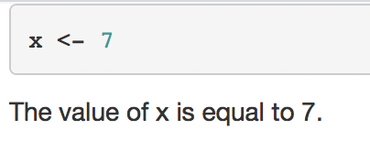

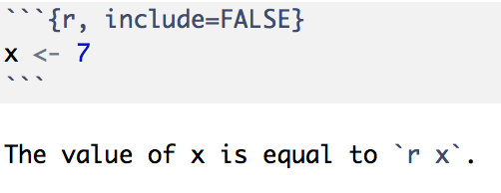

Reproducibility Results
We can embed r output right into our text piece in R Markdown

Slide 12
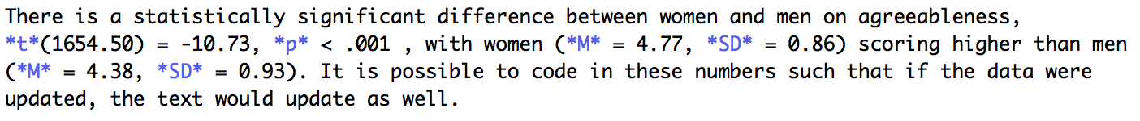
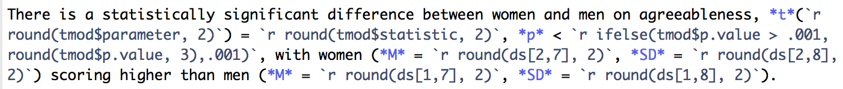
Reproducibility Results
Like a mini r code chunk, you start with `r and end with `
We saw an example with t-test output yesterday
Paragraph we wanted:
Coded into text:

Slide 13
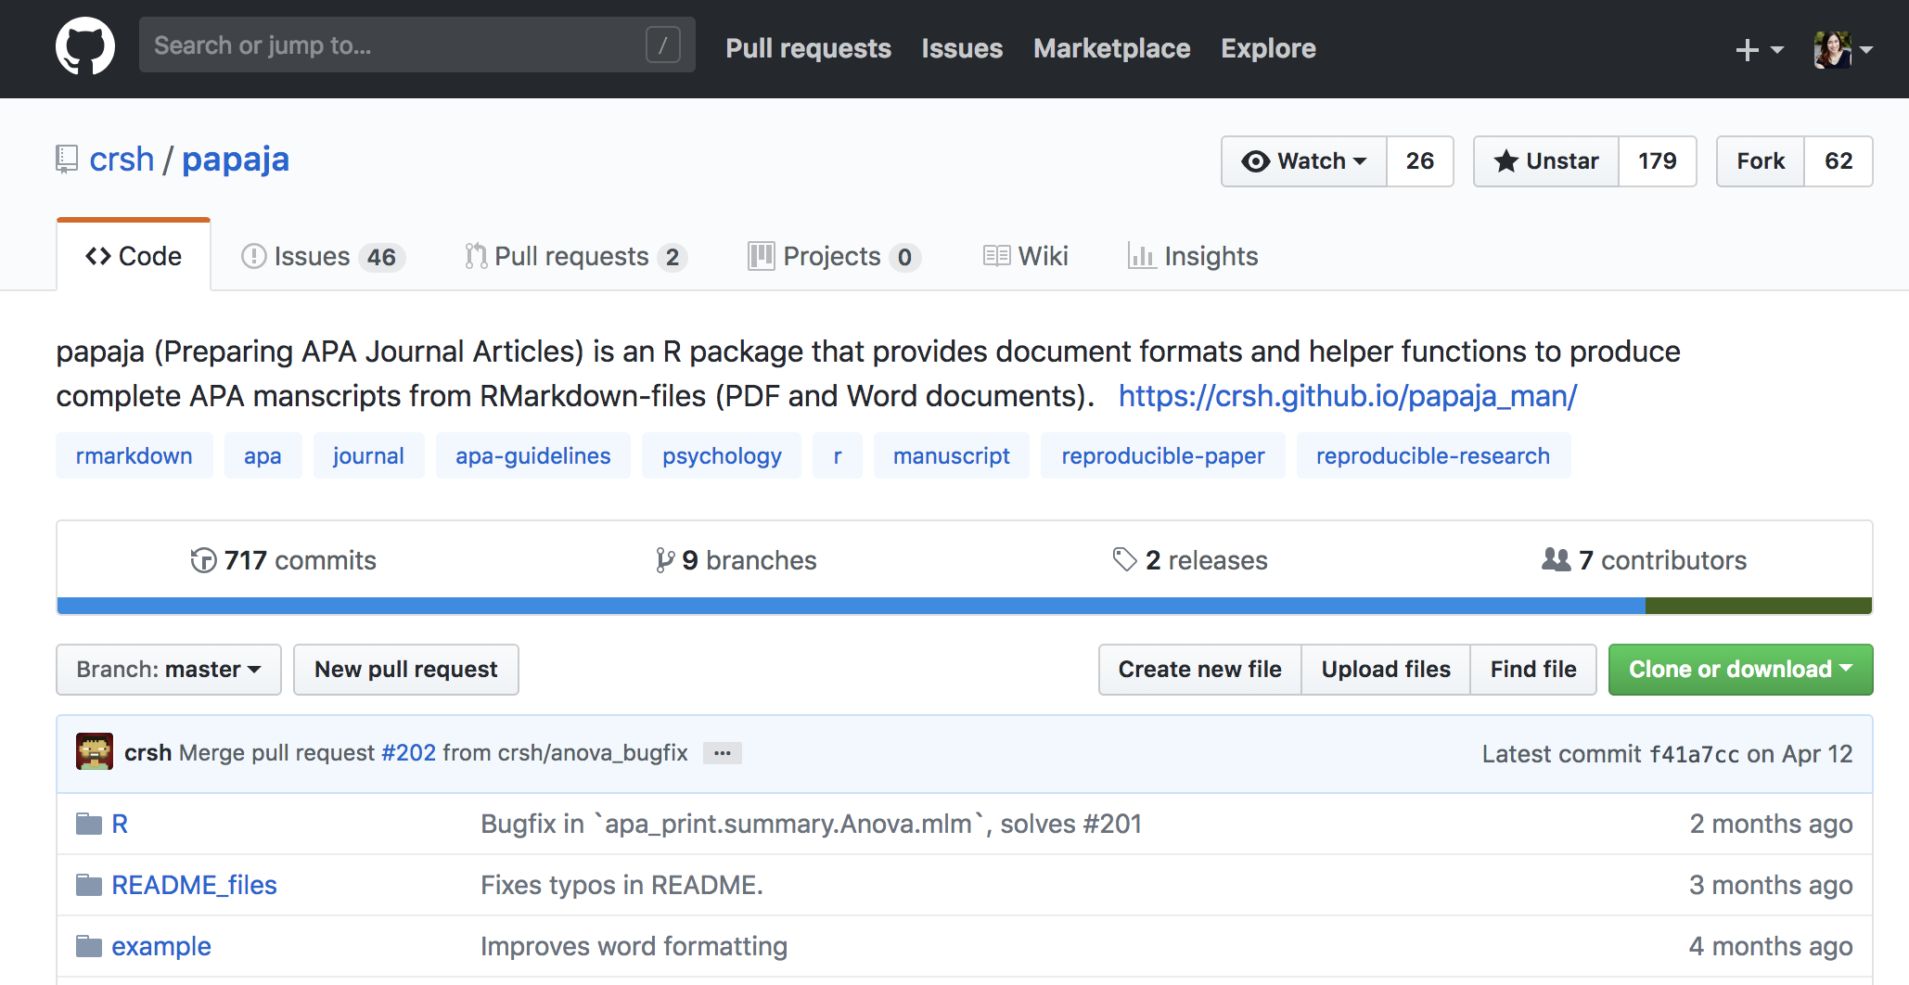
Reproducible APA Style Manuscripts
Aust and Barth (2017) wrote the R package, papaja, that will render that paper in perfect APA style: github.com/crsh/papaja

Slide 14
R Markdown file
APA Style R Markdown/ReproducibleAPAstyle.Rmd

Slide 15
Exploratory Factor analysis

Slide 16
Exploratory Factor Analysis (EFA)
Often we want to be able to describe a relatively large number of items by a much fewer number of factors.
In the bfi dataset there are 25 items measuring personality, but are there just a few underlying factors that are responsible for people’s scores on those items?
We might guess what those are (e.g., extroversion, conscientiousness, etc.), but if we didn’t know we could use EFA to let the data tell us about the underlying dimensions.

Slide 17
Exploratory Factor Analysis (EFA)
Exploratory Factor Analysis (EFA) will use inter-correlations among the items to give us a sense of…
how many factors may be present,
which items can be explained by which factors, and
the extent to which these underlying factors are correlated with each other.
EFA is just that, exploratory
It is important to keep in mind that in the end this is a data driven technique. Meaning that peculiarities in the data may lead you to a rather weird solution.
It takes some sense finesse, listen to what your data is telling you.

Slide 18
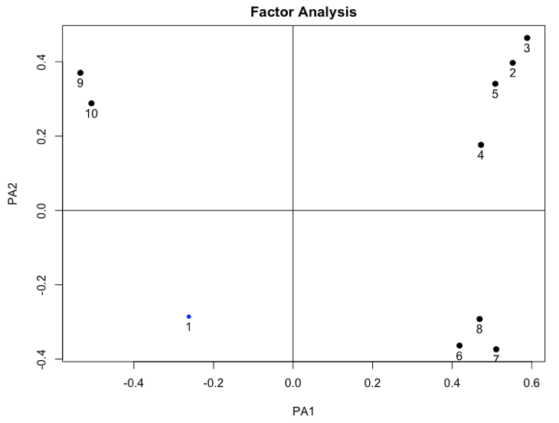
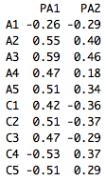
Factor Rotation
Unrotated solution

Slide 19
Factor Rotation
Unrotated solution

Slide 20
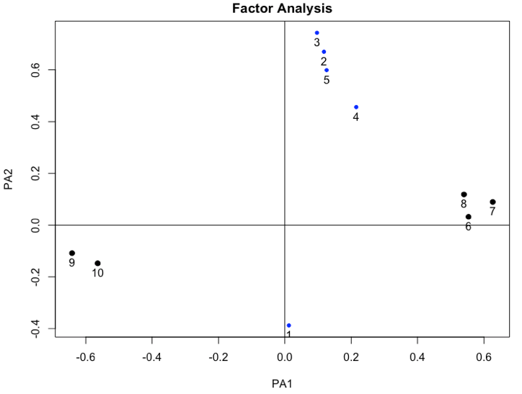
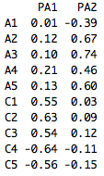
Factor Rotation
Orthogonal rotation

Slide 21
Factor Rotation
Orthogonal rotation

Slide 22
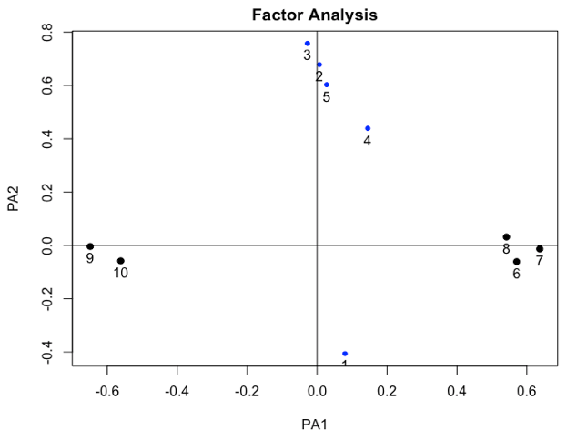
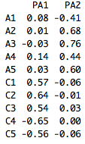

Exploratory Factor Analysis (EFA)
Oblique factor rotation

Slide 23
Exploratory Factor Analysis (EFA)
We will use the psych package
Inference Test | R function
Factor Analysis | fa()
Principal Component Analysis | principal()

Slide 24
R Markdown file
Exploratory Factor Analysis.Rmd

Slide 25
Confirmatory factor analysis

Slide 26
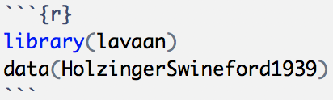
Confirmatory Factor Analysis (CFA)
Mental ability test score from 7th and 8th grade children from two schools
A visual factor measured by 3 variables: x1, x2 and x3
A textual factor measured by 3 variables: x4, x5 and x6
A speed factor measured by 3 variables: x7, x8 and x9
We want to test if indeed these measures fall on these three scales as we hypothesize.
We are confirming a hypothesized factor structure instead of exploring.

Slide 27
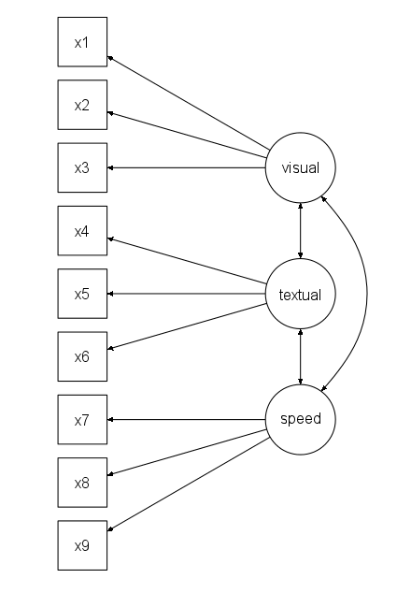
Visual factor: x1, x2 and x3
Textual factor: x4, x5 and x6
Speed factor: x7, x8 and x9

Slide 28
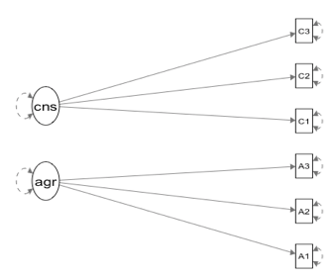
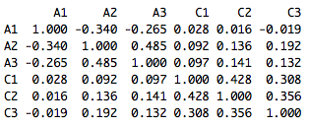
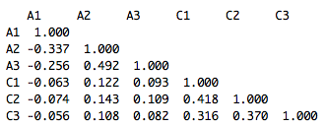
Confirmatory Factor Analysis (CFA)
Does the model we have in our heads actually fit the data?
Assessed with fit statistics
Model
Data Cor matrix
Model implied Cor matrix
Fit?

Slide 29
Confirmatory Factor Analysis (CFA)
We will use the R package lavaan to fit CFAs
Most widely used Structural Equation Modeling (SEM) package in R.
Now with Multilevel SEM!!
lavaan steps:
Step 1: Specify the model
Step 2: Fit the model
Step 3: Ask for the output you want

Slide 30

Step 1: Specify the Model

Slide 31
Step 2: Fit the Model

Slide 32
Step 3: Ask for the output you want

Slide 33
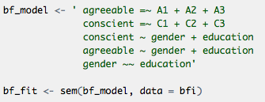
Path Analysis and SEM
Now we can add regression equations in the mix with our latent variables.
We can use our latent variables as predictors (IVs) or as response variables (DVs).
Simultaneously estimate multiple regression equations
A multivariate data analysis approach because we can have multiple response variables.
Think solving a system of equations!

Slide 34
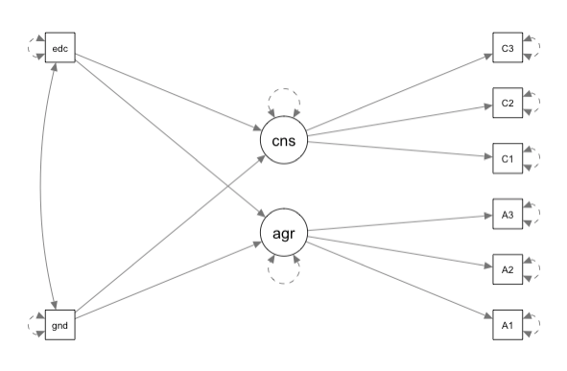
Path Analysis and SEM

Slide 35
R Markdown file
Confirmatory Factor Analysis and SEM.Rmd

